Slide 1
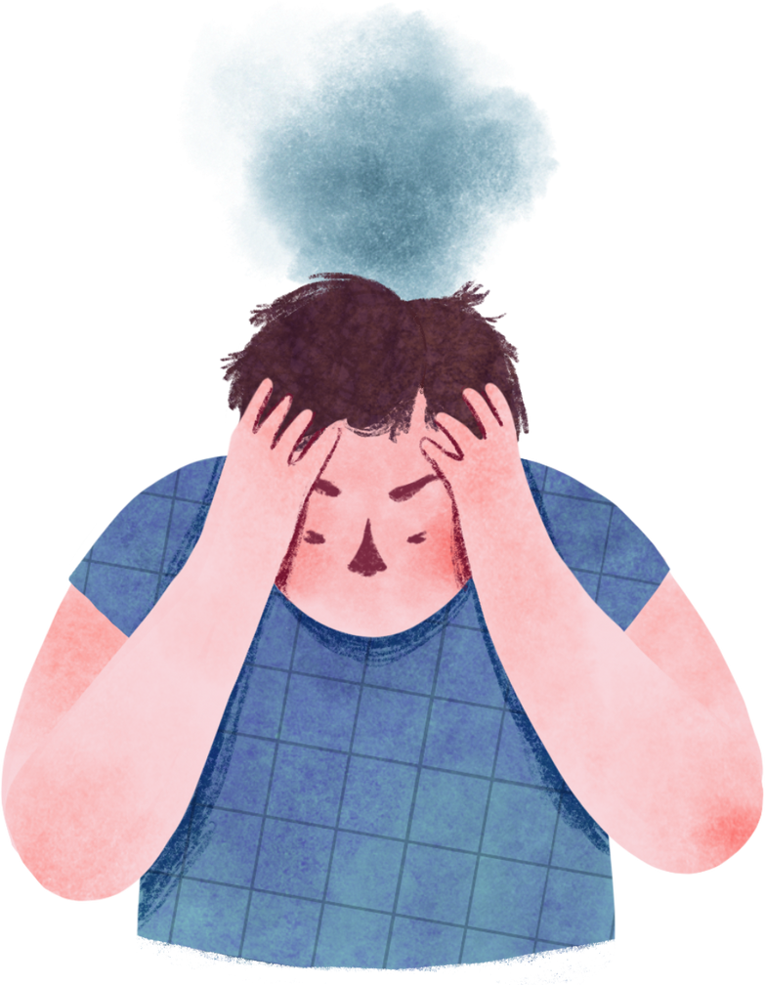
Unemployment Unplugged: Analyzing the COVID Job Market Meltdown
By: Britney Zhu & Myra Arif

Slide 2
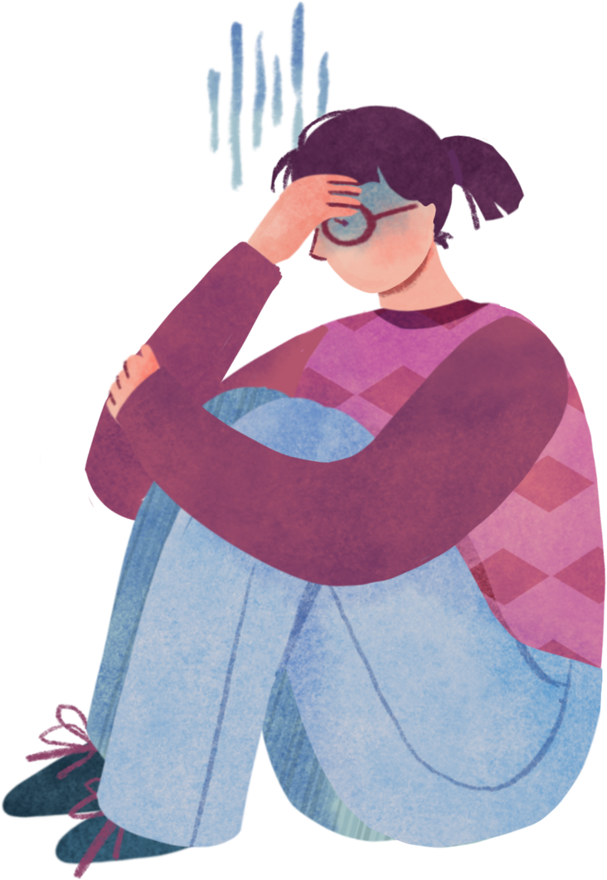

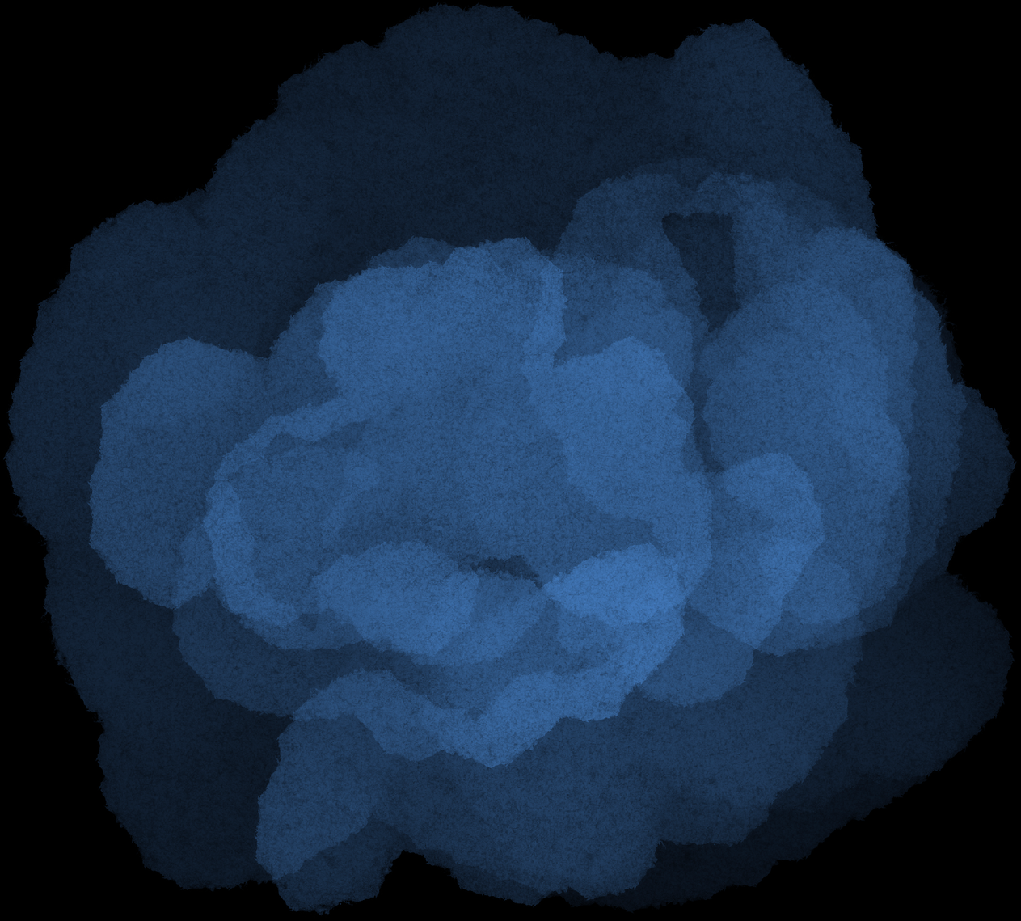
INDEX
01 - Background
02 - Our Goals for This Project
03 - Limitations
04 - Documentation
05 - Conclusions

Slide 3

01 - Background: Unemployment Unfolds Nationally
Unemployment surged nationally as the pandemic took over the United States.
According to the U.S. Bureau of Statistics, in the second quarter of 2020, the unemployment rate was 13%.
Many businesses had to get suspended due to closures and the unemployment rate tripled compared to 2019 (BLS 2021).
Unfortunately, many people lost their jobs and the economy was in turmoil.

Slide 4
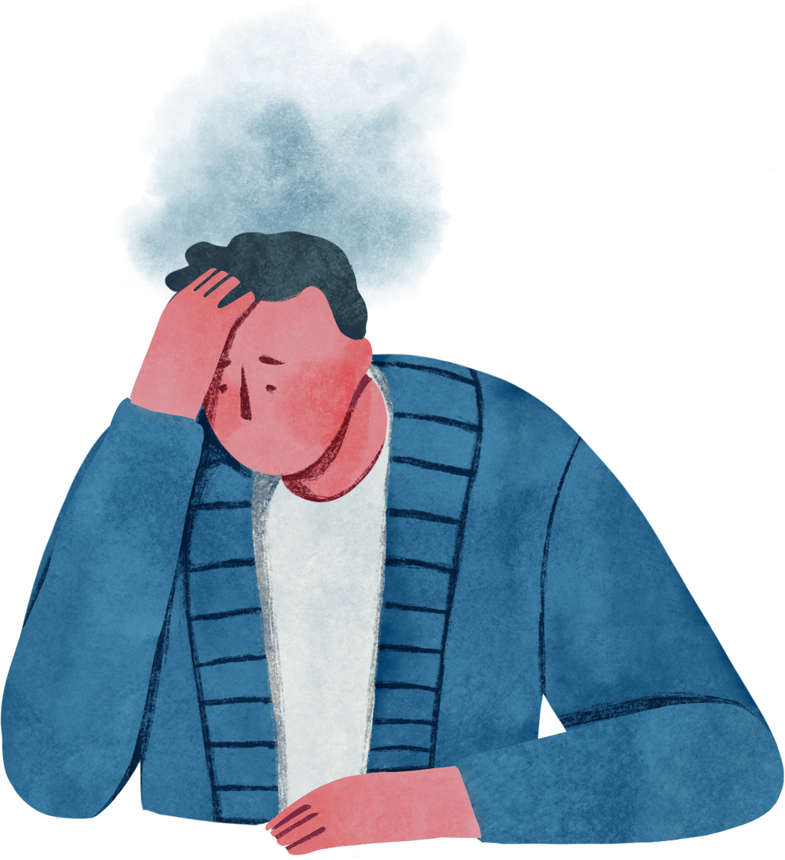
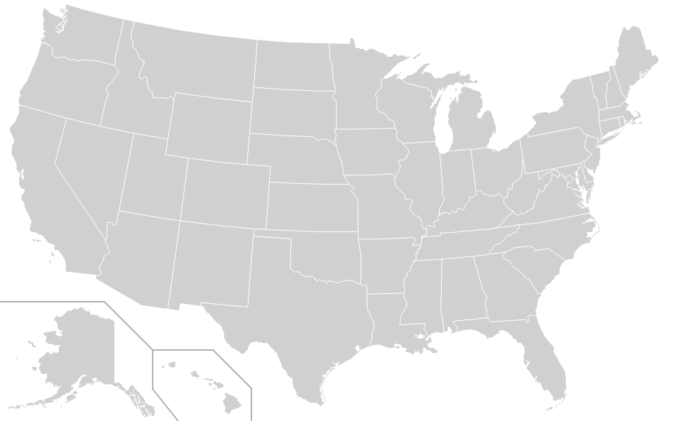
02 - Our Goal: Observing Unemployment at the State Level
Want to look at unemployment rate at the state level
Our Project’s Hypothesis: The unemployment rate for each state will increase with each phase.

Slide 5
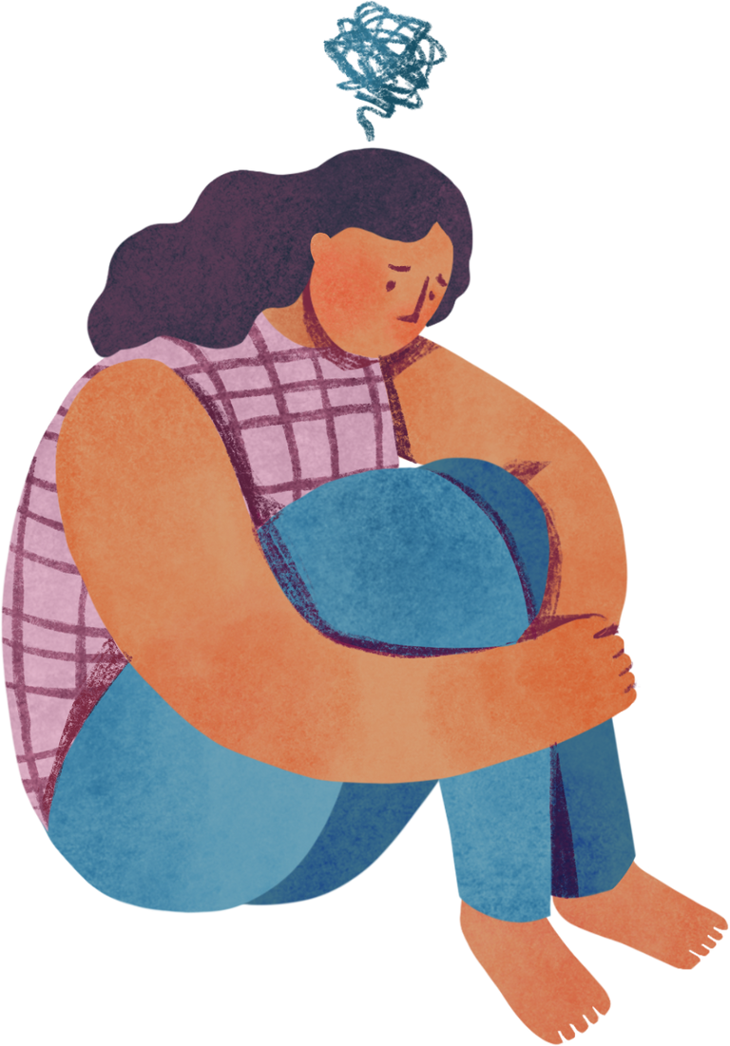
02 - Our Goal: Looking at Data at State Level
Found first covid case in a Science Direct research paper.
Divided the monthly unemployment rate for each state into phases to assess how it changed once COVID cases began in the state
Three Phases:
Phase1before
Phase1after
Phase2after
Functions created:
findthemonths()
find_phase_averages()

Slide 6
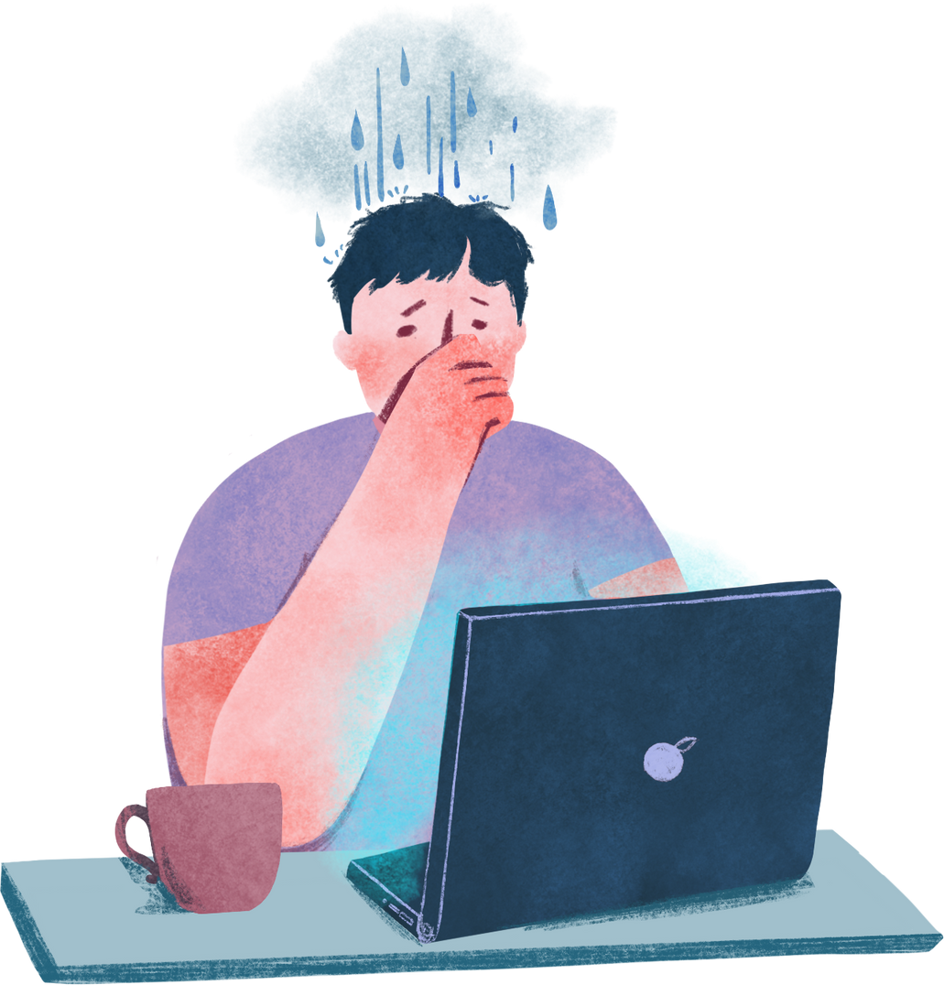
03 - Limitations
Limited data for 2019 so some phase1before calculations only consisted of two months
Were using the census population estimate for each of the states, not the actual census population.
Only look at the 50 states (did not look at Washington DC.)

Slide 7

04 - Documentations
A subplot with 3 histograms of all the states to show the averages of the unemployment people in each of the 3 phases.
2 pie charts, 2 line graphs, and 2 bar graphs to show the maximum percentage changes between phases.
2 pie charts, 2 line graphs, and 2 bar graphs to show the minimum percentage changes between phases.
The finalized table that was used for the graphs.

Slide 8
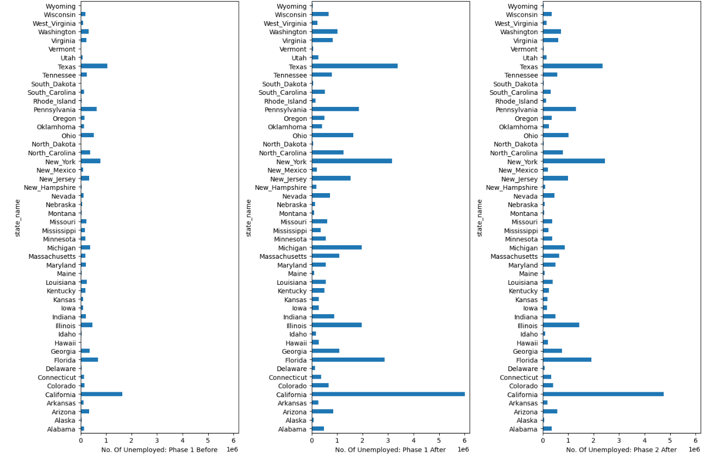

Slide 9
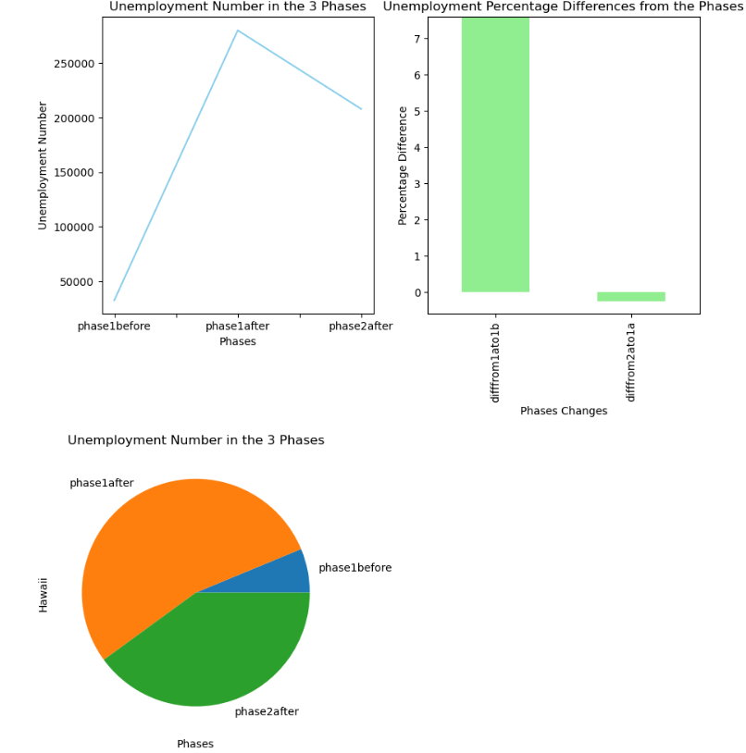
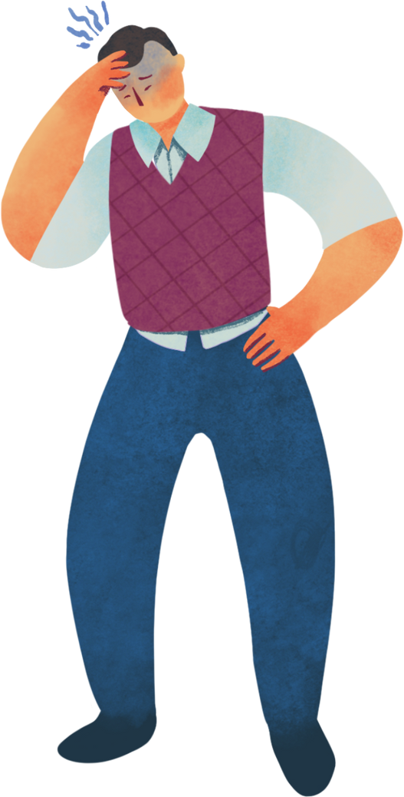
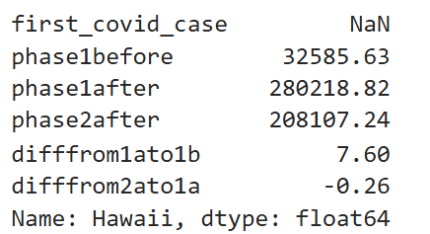
04 - Documentations
Hawaii
the highest percentage difference from phase 1 before to phase 1 after

Slide 10
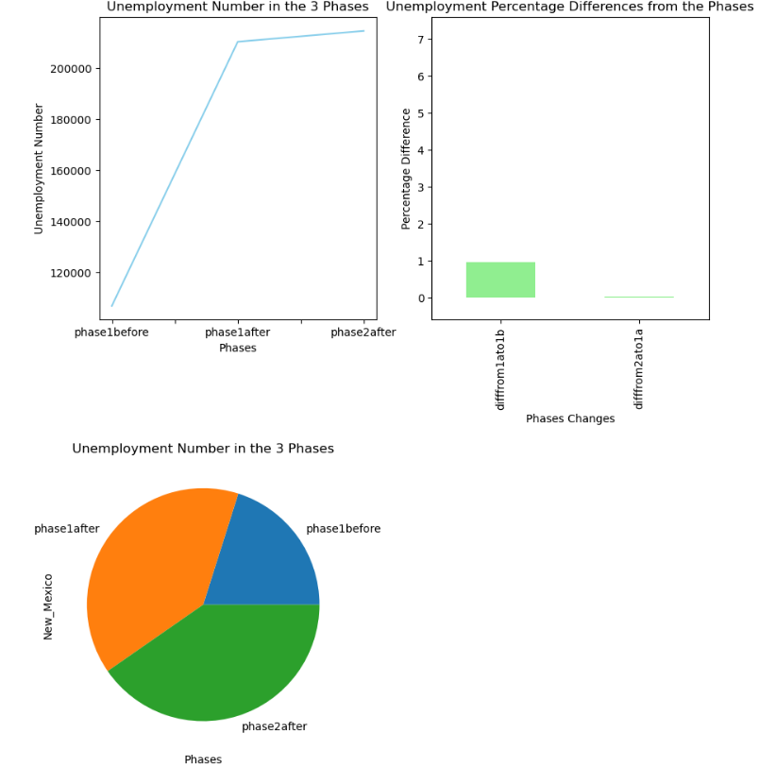
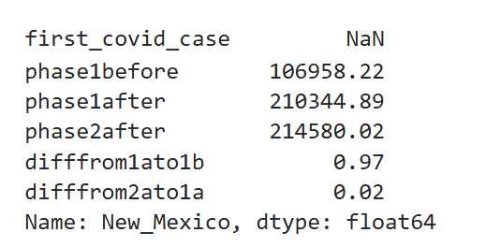
04 - Documentations
New Mexico
the highest percentage difference from phase 1 after to phase 2 after

Slide 11
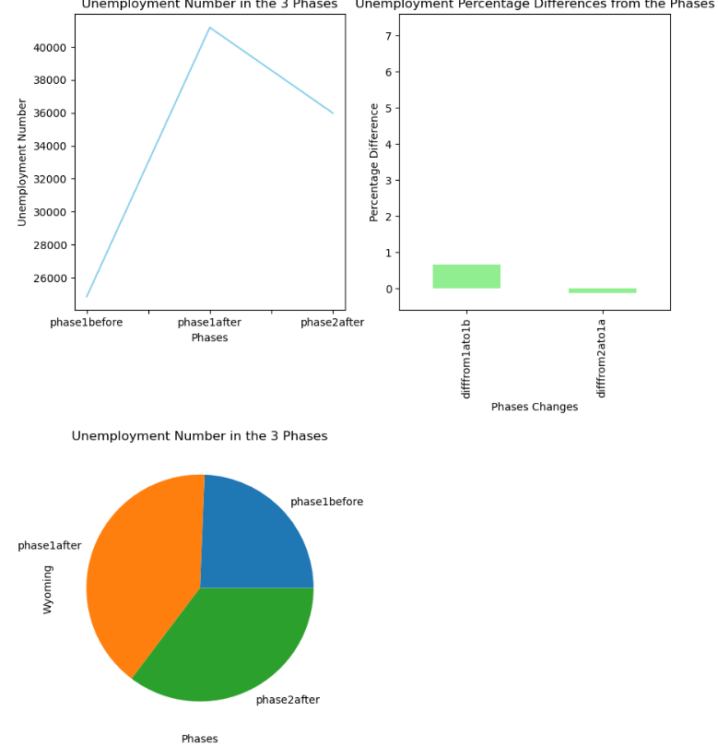
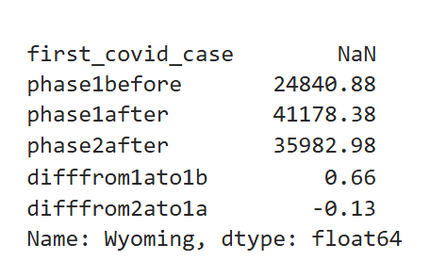
04 - Documentations
Wyoming
the lowest percentage difference from phase 1 before to phase 1 after

Slide 12
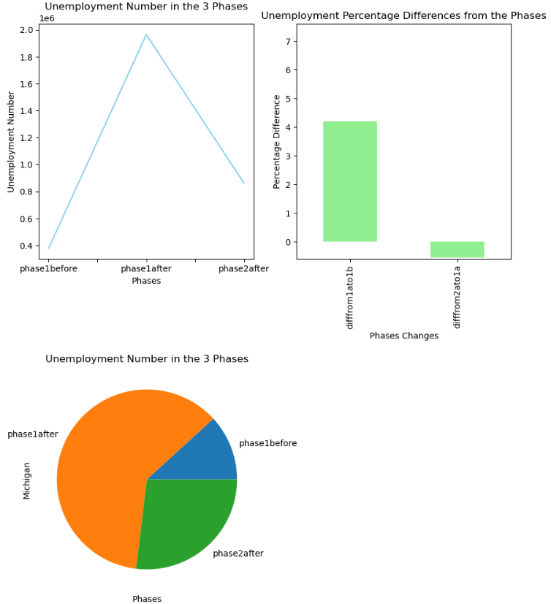
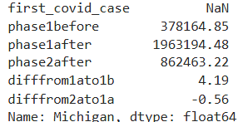
04 - Documentations
Michigan
the lowest percentage difference from phase 1 after to phase 2 after.

Slide 13
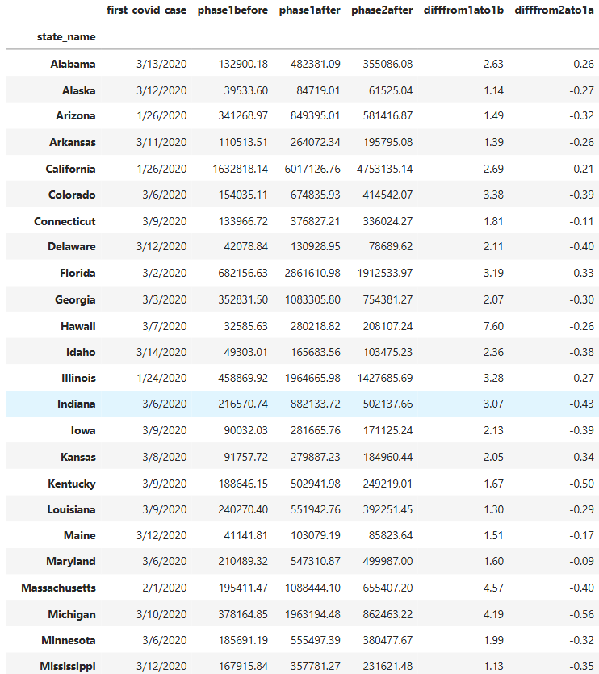
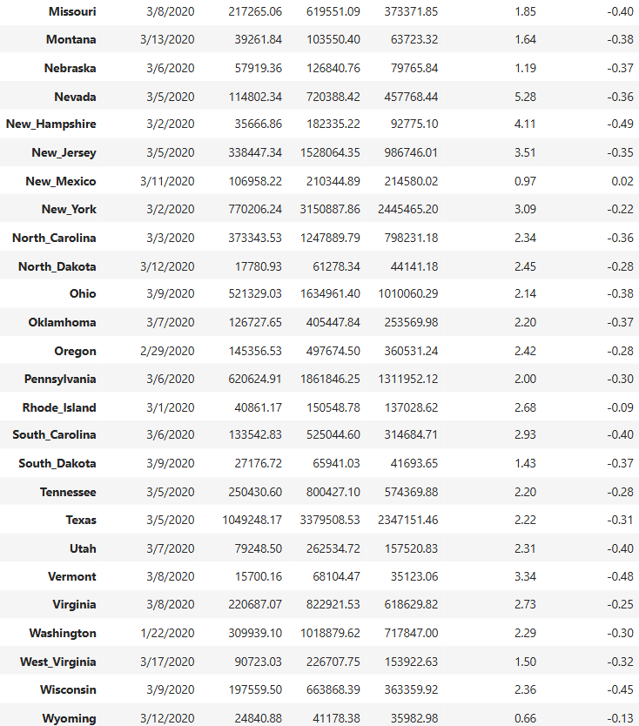
04 - Documentations

Slide 14
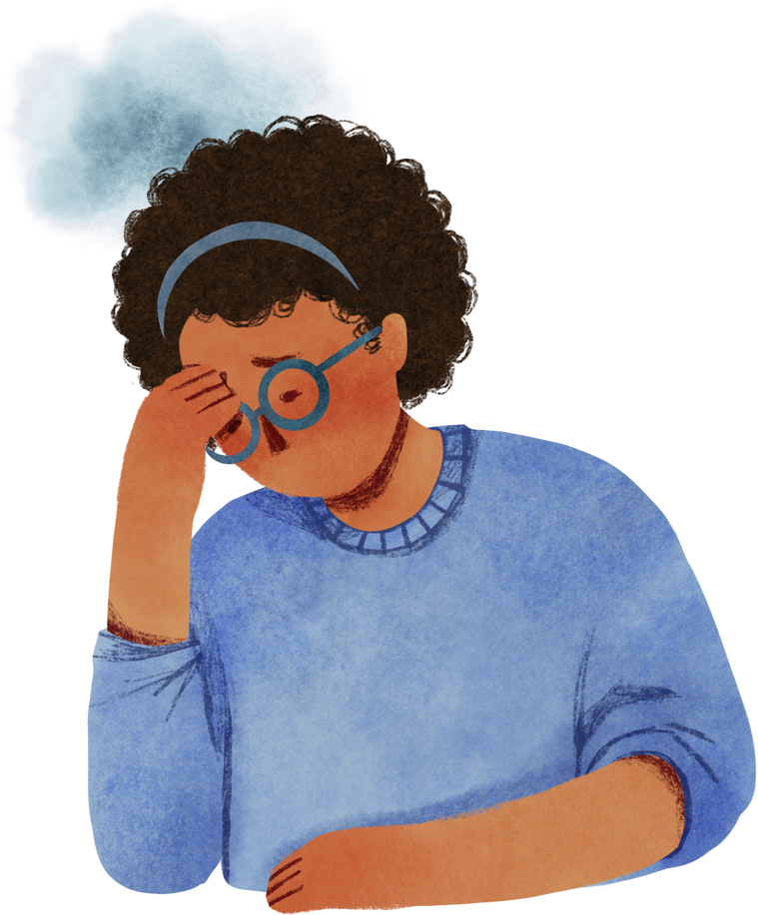
05 - Conclusions
Revisiting our Project’s Hypothesis:
The unemployment rate for each state will increase with each phase
Our results prove that our hypothesis is TRUE! Well partially.
We found out that Wyoming has the lowest percentage difference of 0.66 from phase 1 before to phase 1 after.
This proves that the percentage difference is positive meaning there is a correlation. A positive correlation, as first covid date occurred,
the following 3 months have increase in unemployment rate in all the states. We can infer that as the lowest percentage difference is still positive.
However, the 3rd phase (1st after to 2nd after) did experience a decrease when looking at Michigan (-0.56) but Michigan still experienced an increase in unemployment overall.

Slide 15
06 - References
U.S. Bureau of Labor Statistics. (2021). Unemployment rises in 2020, As the Country Battles the Covid-19 Pandemic. U.S. Bureau of Labor Statistics. https://www.bls.gov/opub/mlr/2021/article/unemployment-rises-in-2020-as-the-country-battles-the-covid-19-pandemic.htm
Unemployment rate (seasonally adjusted). KFF. (2022, May 4). https://www.kff.org/other/state-indicator/unemployment-rate/?currentTimeframe=17&sortModel=%7B%22colId%22%3A%22Location%22%2C%22sort%22%3A%22asc%22%7D
David García-García, Enrique Morales, Cesar de la Fuente-Nunez, Isabel Vigo, Eva S. Fonfría, Cesar Bordehore,
Identification of the first COVID-19 infections in the US using a retrospective analysis (REMEDID),
https://doi.org/10.1016/j.sste.2022.100517.

